Slide 1

Enterprise Software Development
Notes:
TODO: add on slide title 1.2

Slide 2
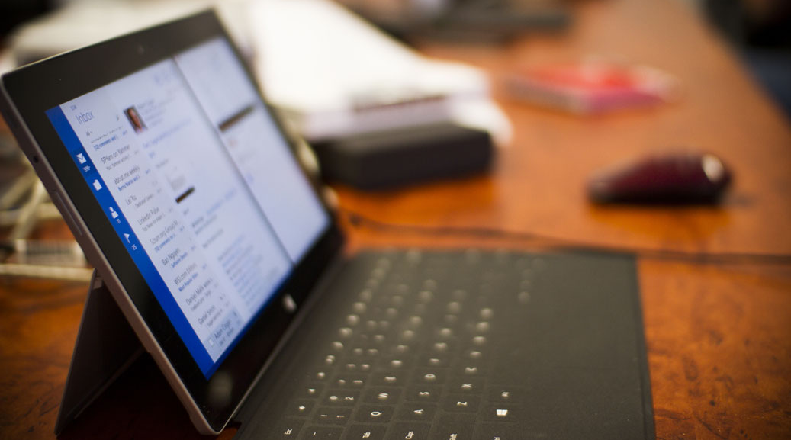
Angular Component Router
Angular Super Powers Tour
Notes:
I wish I had been given this talk

Slide 3
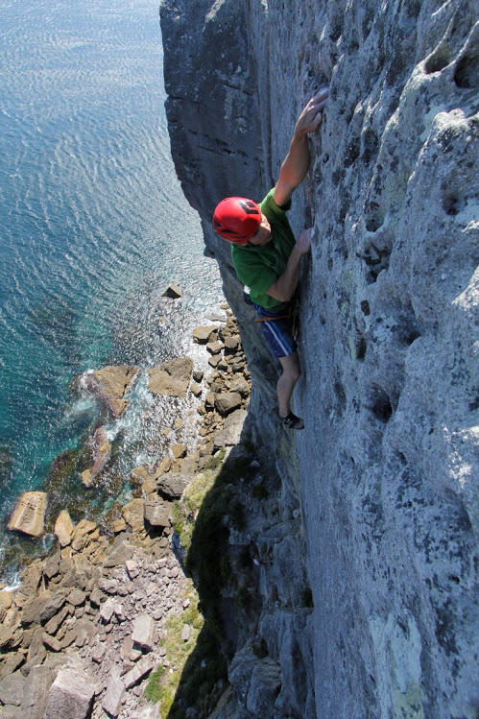
Duncan Hunter
@DuncHunter
Software Architect
Focus on Angular and TypeScript
Rock climber
Notes:
Spend the most of my time building ng and ts
This is actually me in Jervis Bay south of Sydney
Follow me on twitter

Slide 4

Agenda
1. Why a new router
2. Routing basics
3. Life cycle hooks
3. More information
Notes:
Approx. 45min for the 10 qu and the Q&A

Slide 5
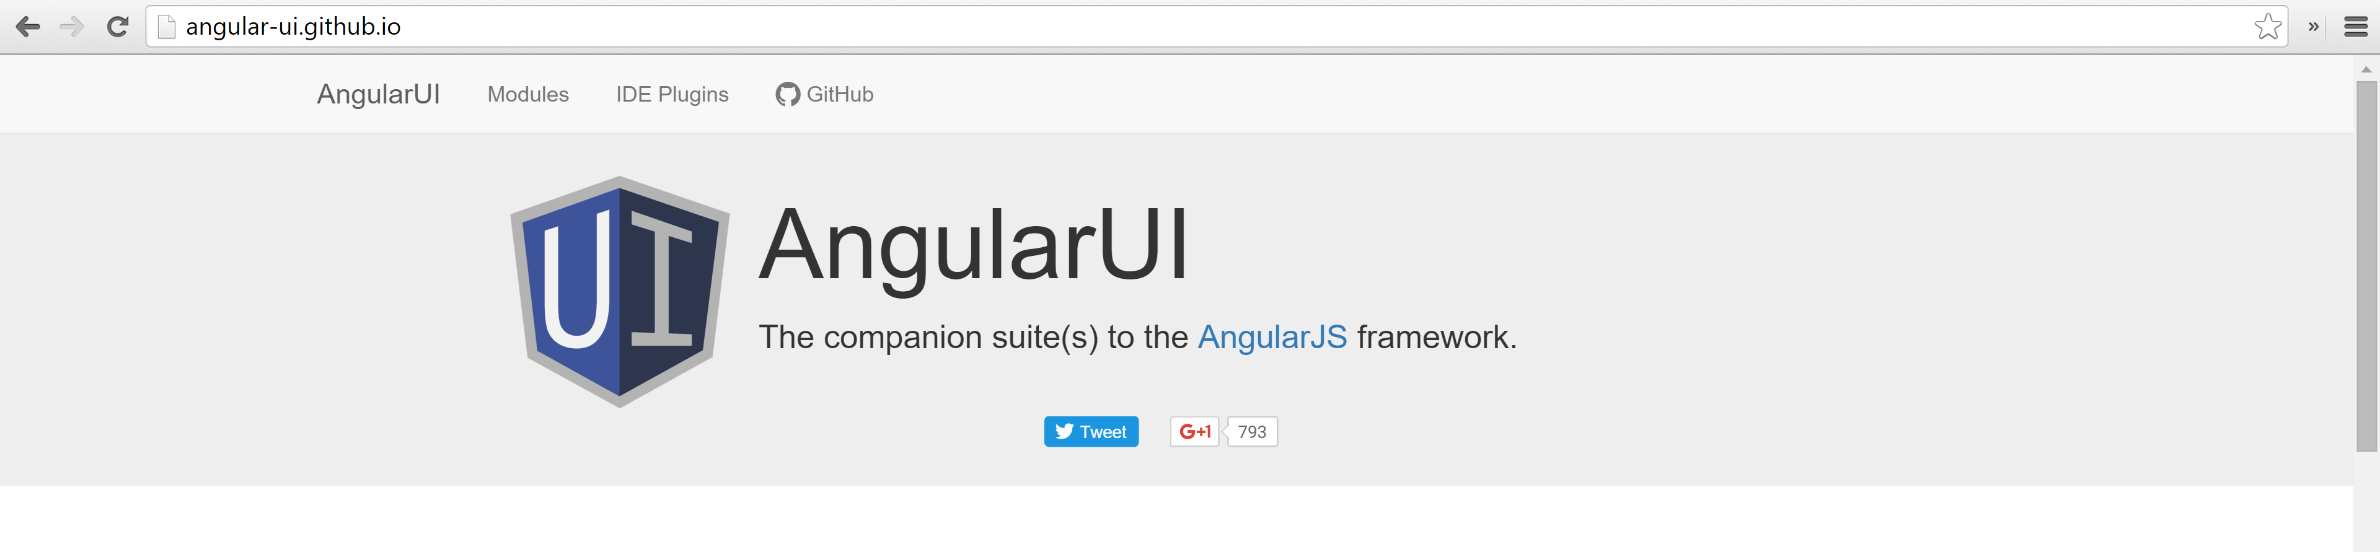
Why a new component router?
Angular2 has components not controllers
No child routes in AngularJs 1x
Everyone needed to use ui-router to make it work

Slide 6
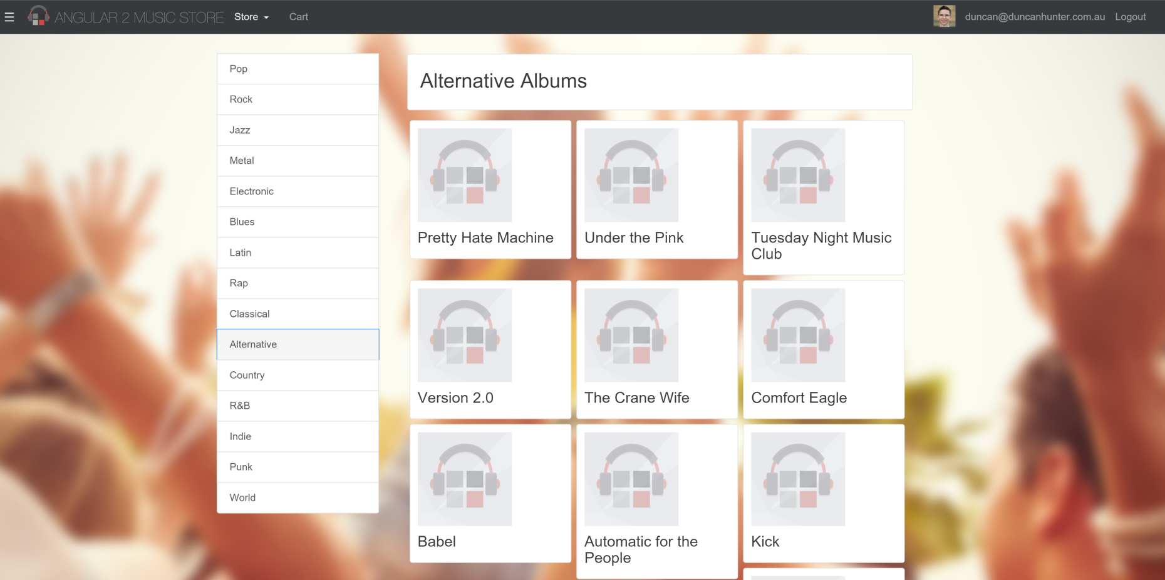
<router-outlet></router-outlet>

Slide 7
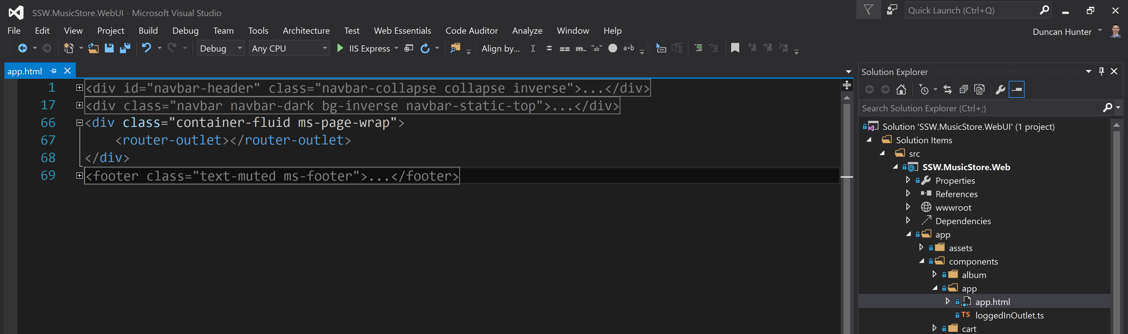

Slide 8
Routing Basics
@Component( … ) @RouteConfig([ { path: '/', component:DashBoardComponent, as: Dashboard }
]) class AppComponent {}

Slide 9
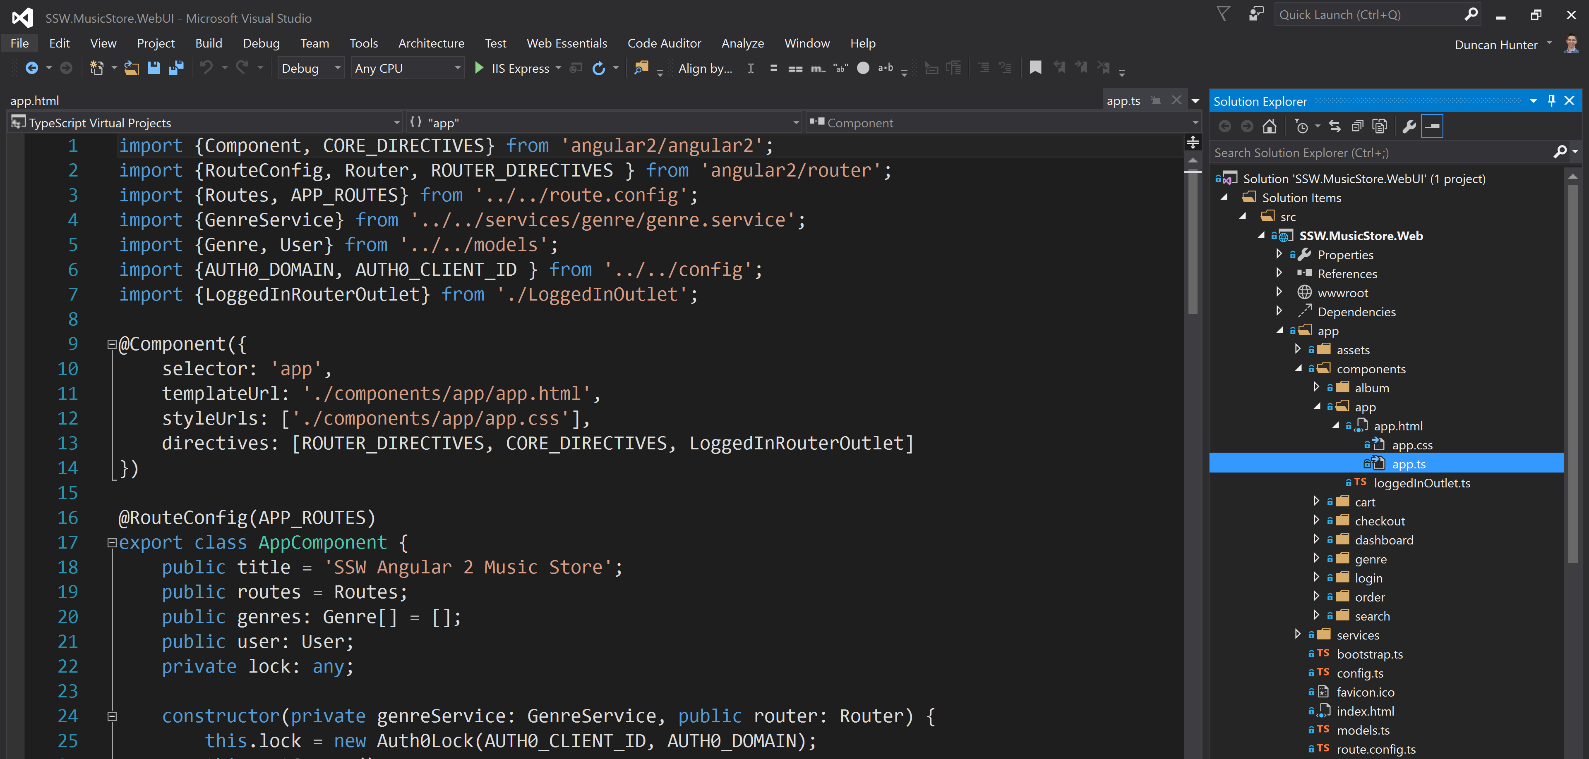

Slide 10
<router-outlet></router-outlet>

Slide 11
<router-outlet></router-outlet>

Slide 12
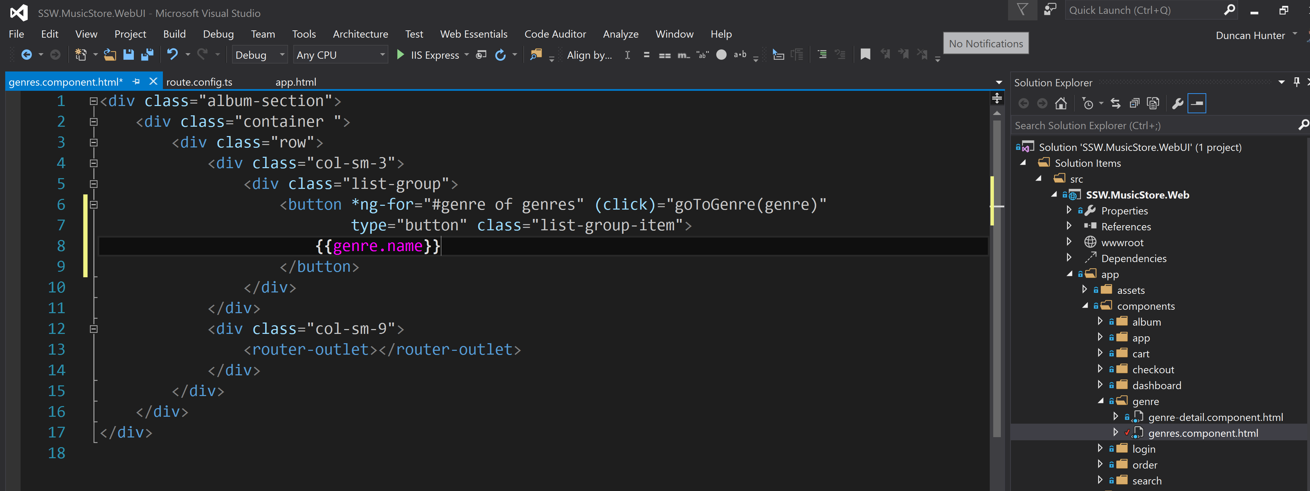

Slide 13
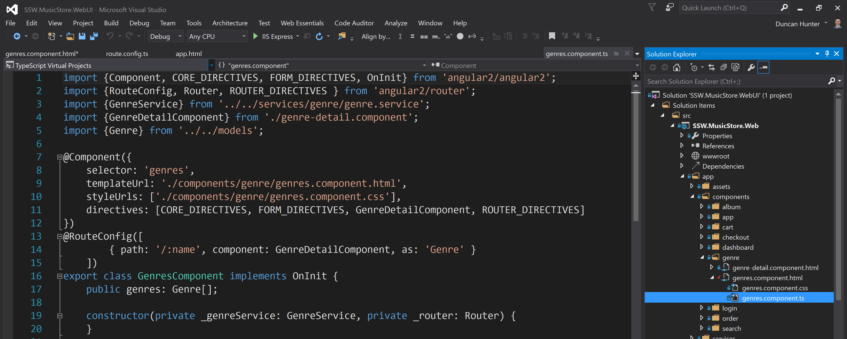

Slide 14
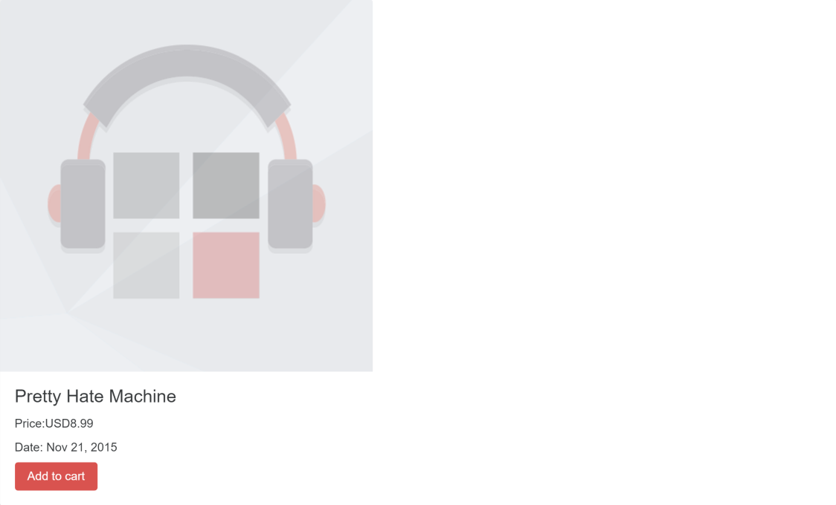
<router-outlet name=“cart”>
</router-outlet>
Notes:
{ path: '/album/:id', component: AlbumComponent },

Slide 15
Parent
Child
AUX
Notes:
{ path: '/album/:id', component: AlbumComponent },

Slide 16
Routing Basics
@Component( … ) @RouteConfig([ { path: '/', component:DashBoardComponent, as: Dashboard },
{ path: '/album/:id', component: AlbumComponent , as: Album },
{ path: '/genres/...', component: GenresComponent , as: Genres },
{ aux: '/genre', component: GenreComponent , as: Genre }, ]) class AppComponent {}

Slide 17
Links
<a [router-link]="[ '/Index' ]">home</a>
AppCmp's @RouteConfig { path: '/', component: HomeCmp, as: 'Index' }
<a href="/">home</a>

Slide 18
Lifecycle hooks - @CanActivate
@CanActivate​(() => { ... }) class MyComponent() {}
A component decorator defining a function that the router should call first to determine if it should activate this component. Should return a boolean or a promise.

Slide 19
Lifecycle hooks - onActivate
onActivate​(nextInstruction, prevInstruction) { ... }
After navigating to a component, the router calls component's onActivate method (if defined).

Slide 20
Lifecycle hooks - onReuse
onReuse​(nextInstruction, prevInstruction) { ... }
The router calls the component's onReuse method (if defined) when it re-uses a component instance.

Slide 21
Lifecycle hooks - onDeactivate
onDeactivate​(nextInstruction, prevInstruction) { ... }
Called before the directive is removed as the result of a route change. May return a promise that pauses removing the directive until the promise resolves.

Slide 22
Code walk through

Slide 23
Summary
1. Why the new router
2. Routing basics
3. Advanced routes
4. Links
Notes:
NOTE agenda same as finish
Approx. 45min for the 10 qu and the Q&A

Slide 24
Thank you! info@ssw.com.au www.ssw.com.au Sydney | Melbourne | Brisbane | Adelaide

